Slide 1
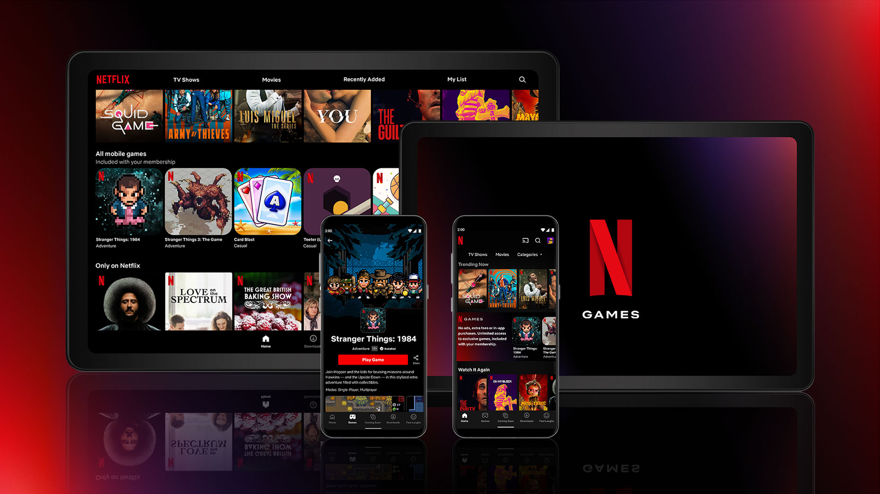


TECHNOLOGY IN BUSINESS PROJECT
PRESENTED BY
APEKSHA CHIKANE 23030141014
PRATIK DESHMUKH 23030141018
PRESENTED TO,
SHASHANK GAIKWAD

Slide 2

TABLES OF CONTENTS
ABOUT DATASET
PROBLEM STATEMENT
OBJECTIVE
KEY PERFORMANCE INDICATORS(KPIs)
SQL
DATA CLEANING AND PREPARATION
TABLUEAU VISUALIZATION
NETFLIX DASHBOARD
OVERALL INSIGHTS AND CONCLUSION
SUGGESTIONS
TOOLS USED
REFERENCES

Slide 3

ABOUT DATASET
Kaggle Link: https://www.kaggle.com/datasets/shivamb/netflix-shows
Records:6235
Attributes:
Show_id: Unique identifier for each show
type: Indicates whether it's a movie or a TV show
title: Title of the show
director: Director of the show
cast: Cast of the show
country: Country of origin for the show
date_added: Date when the show was added to Netflix
release_year: Year when the show was released
rating: Age rating for the show
duration: Duration of the show
genre: Categories or genres the show belongs to
description: Brief description of the show

Slide 4

PROBLEM STATEMENT
OBJECTIVE
The primary objective of this project is to analyze the Netflix dataset to distinguish between movies and TV shows, uncovering trends, patterns, and insights related to viewer preferences, content distribution, and regional variations.
The analysis will focus on:
Temporal distribution of content additions on Netflix.
Ratio of movies to TV shows, offering insights into content diversity and viewer preferences.
Geographical distribution of content, identifying regions with significant content contributions.
Viewer age group preferences, analyzing duration trends and consumption patterns for both movies and TV shows.
The Netflix platform hosts a vast and diverse content library, including both movies and TV shows from various countries and genres. However, the sheer volume and variety of content make it challenging to identify key trends, viewer preferences, and regional variations. This analysis seeks to address these challenges by examining the Netflix dataset to uncover meaningful insights into content distribution, viewer demographics, and regional contributions.

Slide 5
KEY PERFORMANCE INDICATORS(KPIS)
Content Upload Trends: Number of movies and TV shows added to Netflix over time, broken down by year
Movies to TV Shows Ratio: The proportion of movies to TV shows available on Netflix, highlighting content diversity.
Regional Content Distribution: Number of movies and TV shows produced in different countries, identifying key content-producing regions.
Viewer Age Group Preferences: Distribution of content duration and age ratings, providing insights into the preferred content length and age group preferences.
Genre Distribution: Analysis of the listed genres/categories, determining the popularity of various content types across different regions and time periods.

Slide 6
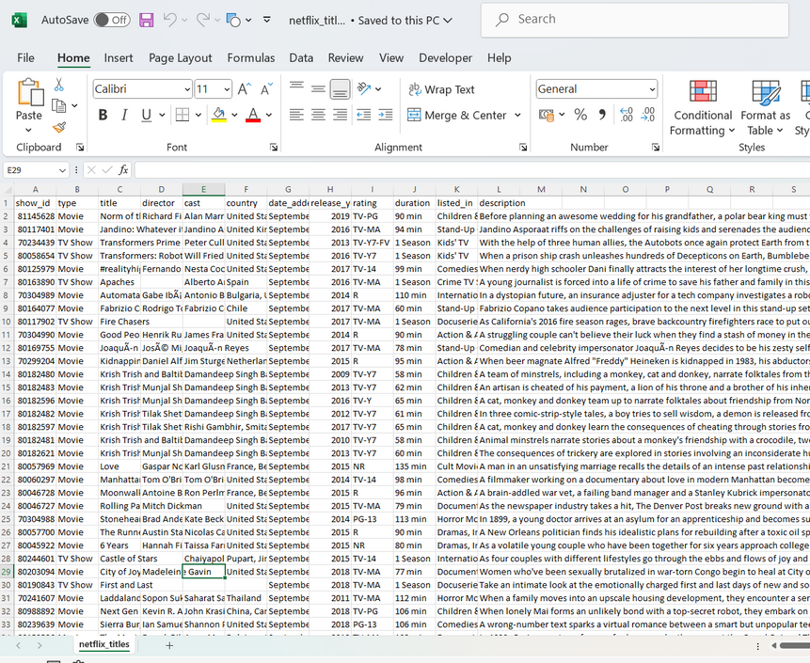
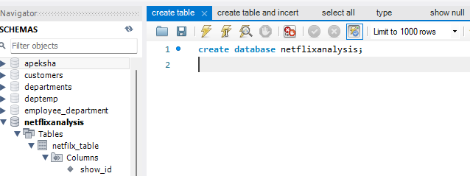
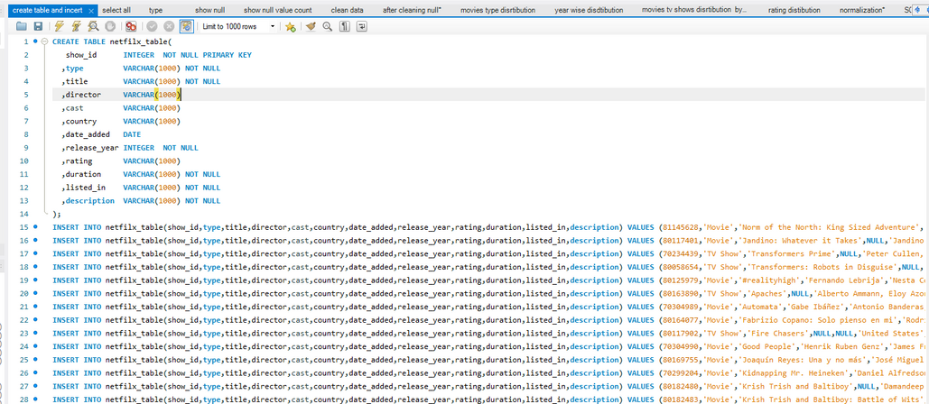
SQL
DATASET
CREATED DATABASE
CREATED TABLE AND INSERTED VALUES

Slide 7
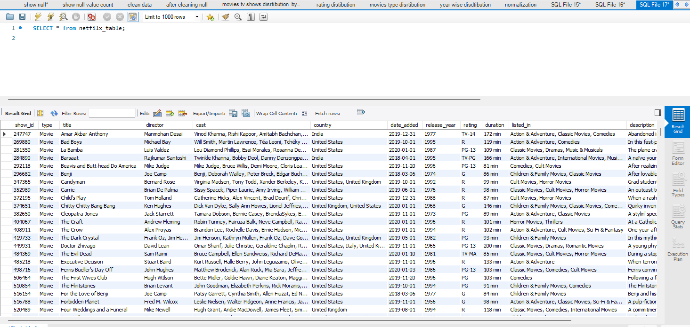
NETFLIX TABLE DATA

Slide 8
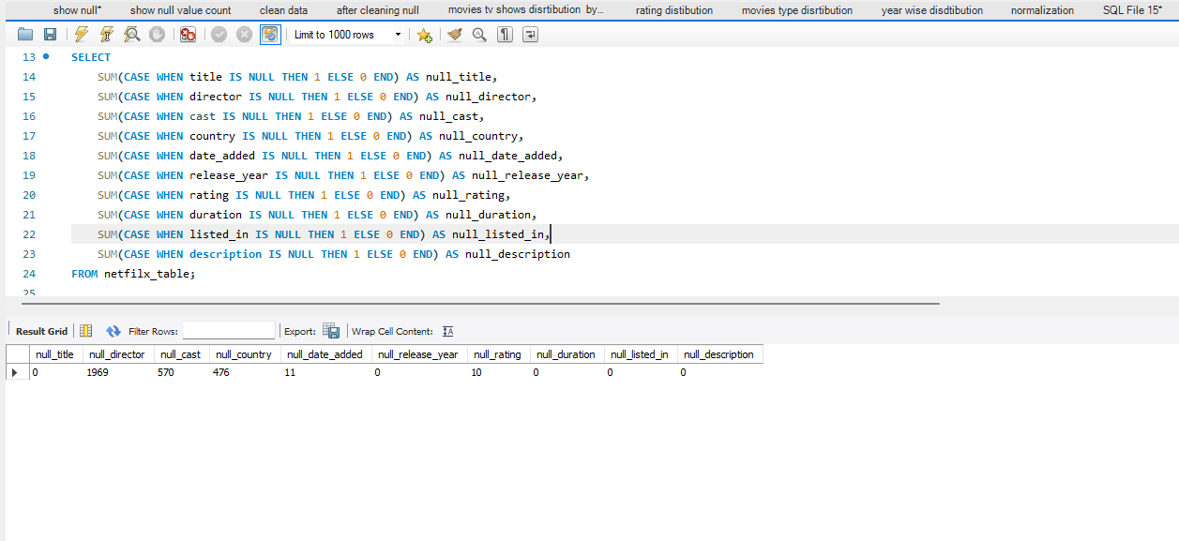
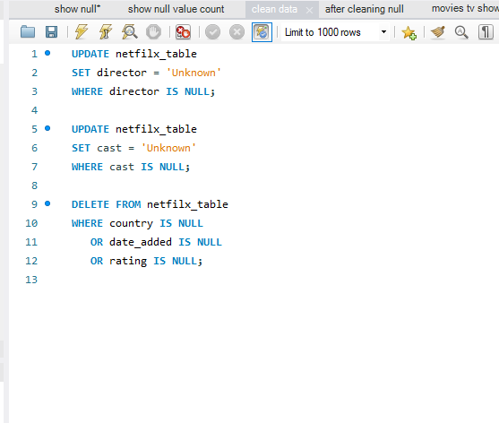
DATA PREPROCESSING
NULL VALUES COUNT COLUMN WISE
HANDLED NULL VALUES

Slide 9
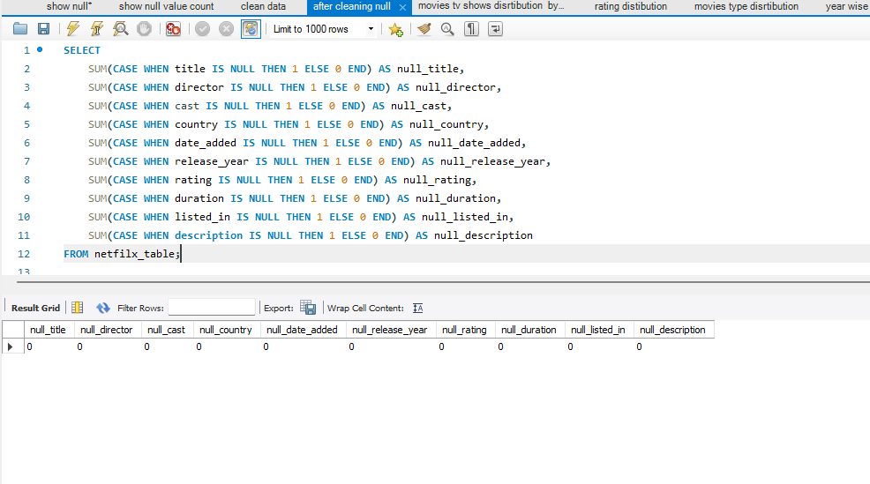
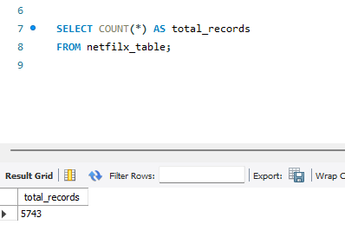
DATA PREPROCESSING
DATA AFTER PREPROCESSING

Slide 10
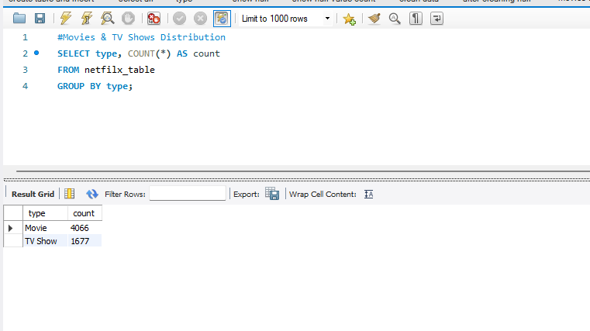
SQL QUERIES FOR ANALYSIS
Movies and Tv shows Distibution

Slide 11
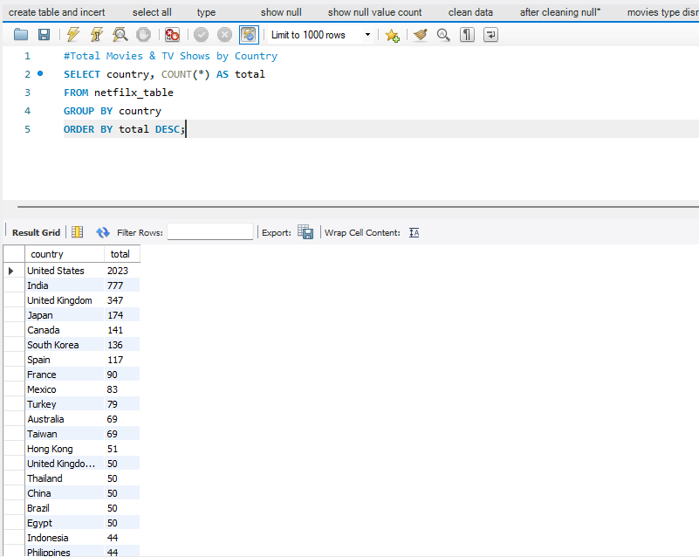
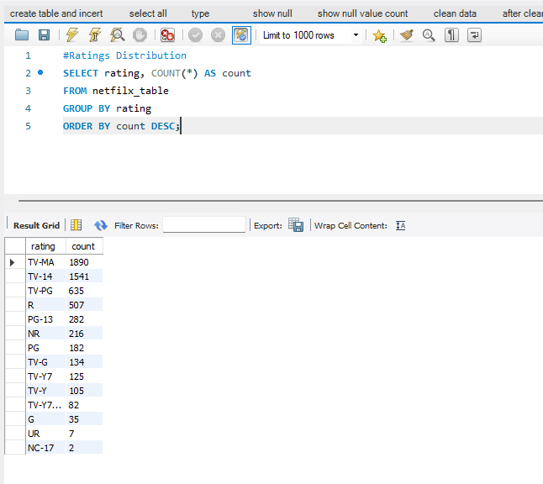
SQL QUERIES FOR VISUALIZATION
Movies and Tv shows by Country
Rating wise Distibution

Slide 12
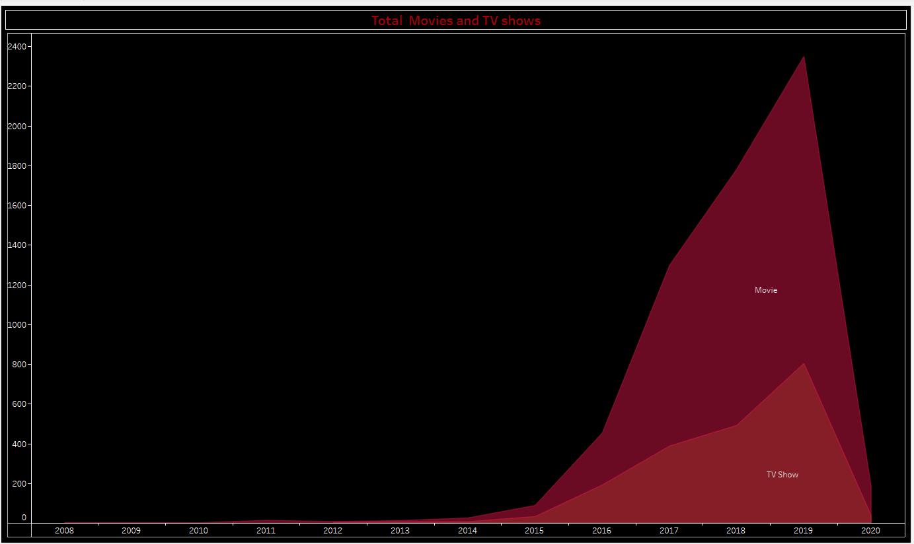
TABLEAU VISUALIZATION
TOTAL MOVIES AND TV SHOWS
INSIGHTS
2019 Peak in Content Additions: The graph shows that 2019 experienced the highest number of content additions, with both movies and TV shows reaching a peak. This suggests that Netflix was heavily focused on expanding its content library during this year.
Significant Growth Leading Up to 2019: The sharp increase in content additions begins around 2015, with steady growth each year, culminating in the 2019 peak.
Movies vs TV Shows: Throughout the timeline, movies consistently outnumber TV shows, reflecting a possible preference or strategic focus on movies during this period.

Slide 13
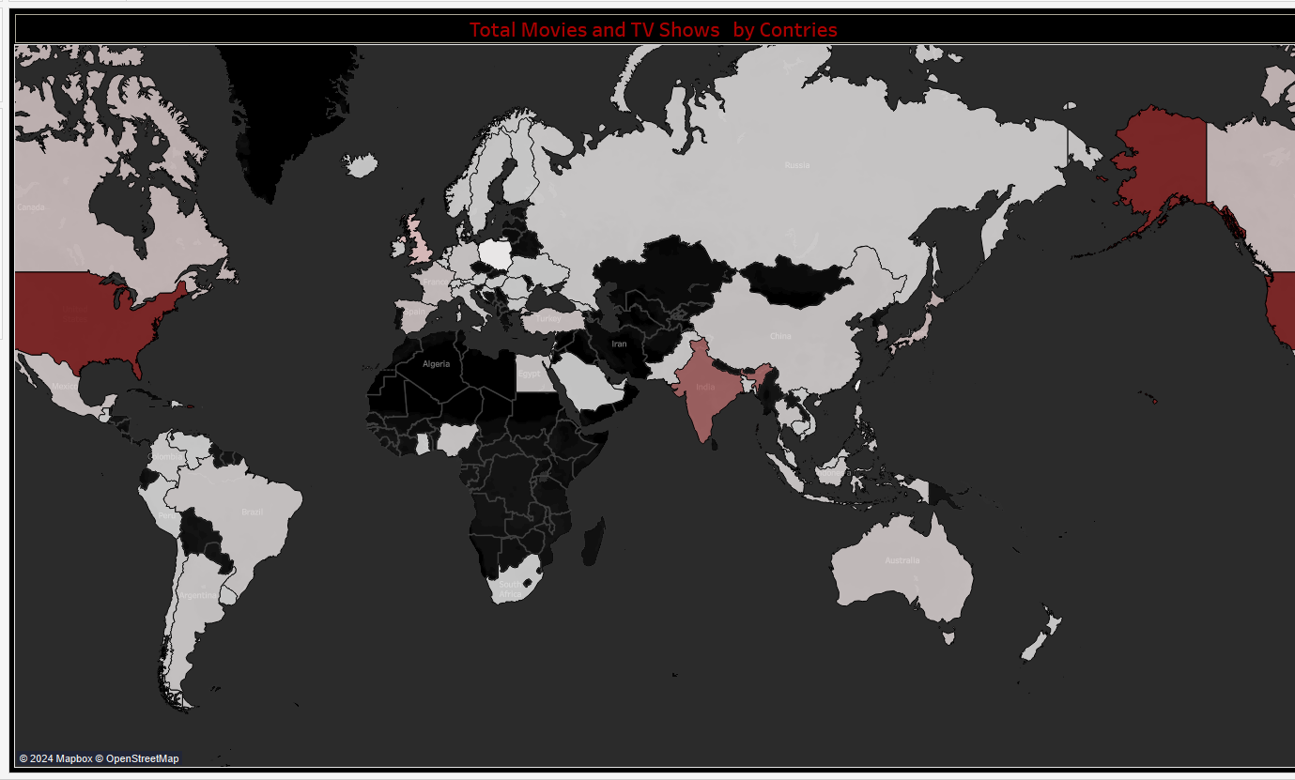
TOTAL MOVIES AND TV SHOWS BY COUNTRY
AROUND THE WORLD
Dominance of the United States: The map shows that the United States is a major contributor to Netflix’s content library, with the darkest shade indicating the highest number of movies and TV shows. This aligns with the understanding that the U.S. is a significant hub for film and television production.
Sparse Contributions from Other Regions: The map shows that many regions, particularly in Africa and some parts of Asia, have minimal content contributions. This could indicate either a lower production volume in these regions or that Netflix has not yet fully tapped into these markets.
Strong Contributions from India: India also stands out as a significant content provider, with a large number of movies and TV shows. This suggests that Netflix has a strong presence in the Indian market, likely driven by the country's prolific film industry (Bollywood) and regional cinema
Market Opportunities: There may be opportunities for Netflix to expand its content offerings in regions that currently contribute less, potentially by investing in or acquiring more local productions from underrepresented areas.

Slide 14
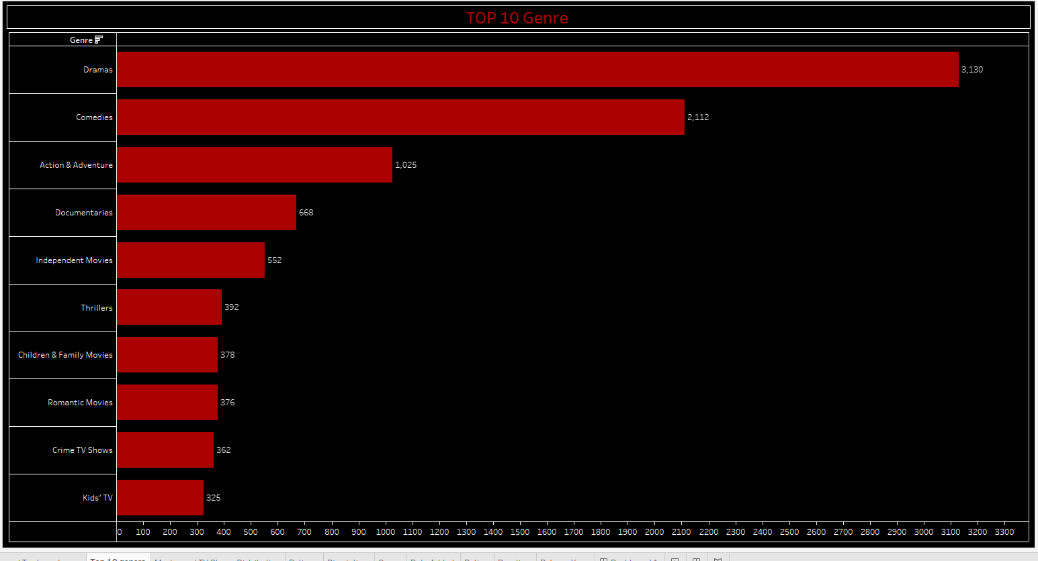
TOP TEN GENRE
Dramas are the most frequent genre on Netflix, followed by Comedies and action and Adventure. Kids' TV has the fewest entries among the top genres, suggesting a lesser focus on children’s content compared to others.

Slide 15
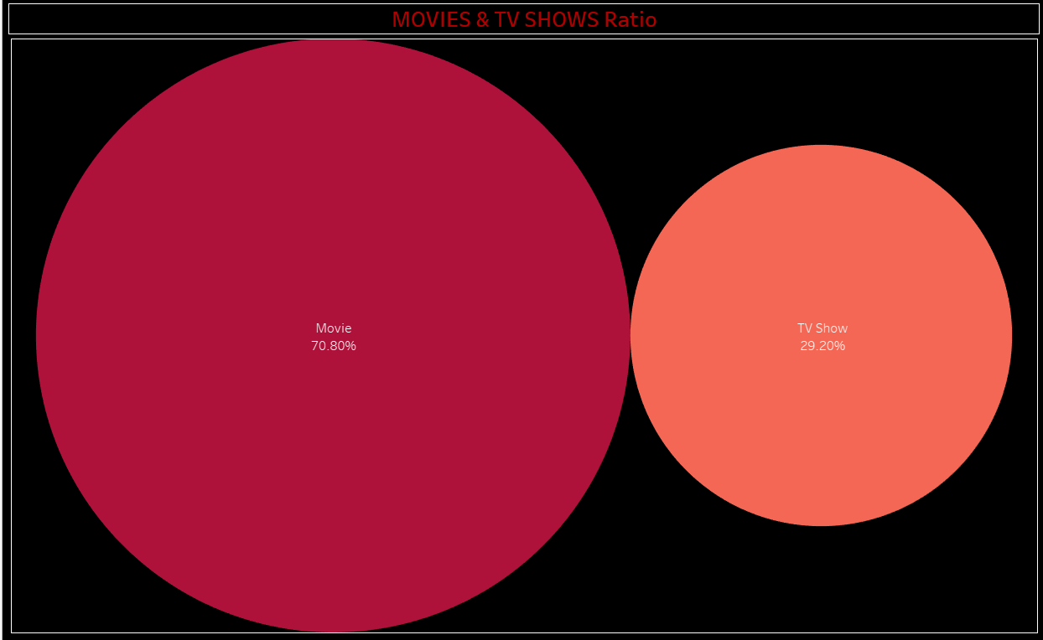
MOVIES AND TV SHOWS RATIO
Netflix's content is primarily movies, which make up 70.80% of the platform, while TV shows account for the remaining 29.20%, showcasing a strong focus on film content.

Slide 16
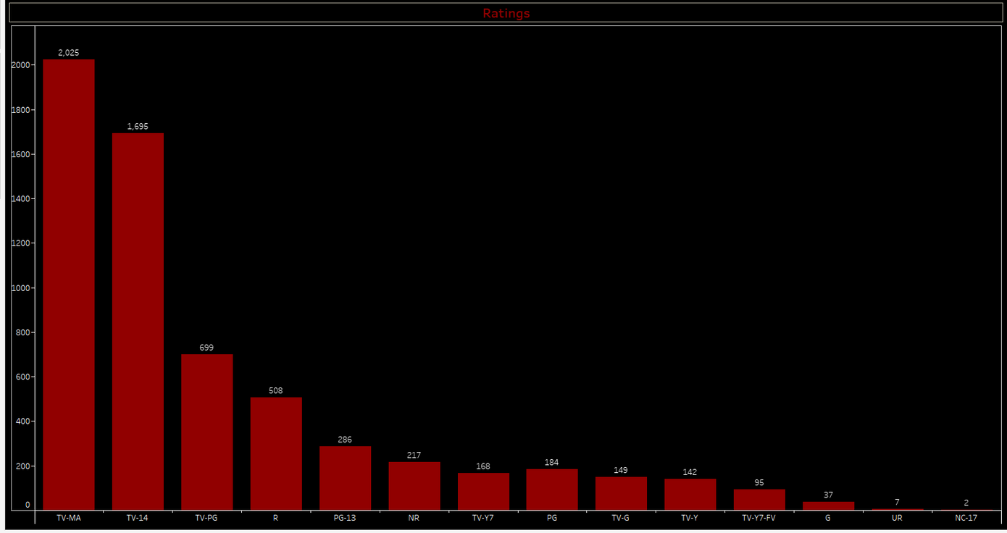
TOP 10 RATINGS
Insights:
The largest portions of content are aimed at mature audiences (TV-MA, TV-14, and R), indicating that Netflix has a strong focus on adult-oriented content.
There is still a suitable amount of content for younger audiences, although it makes up a smaller proportion of the overall library.
The distribution suggests that Netflix is heavily weighted towards providing content that appeals to teens and adults, with fewer options available for younger children.
Age Mapped to Rating:
G: All Ages
TV-Y: All Children
TV-Y7: Older Children
TV-G: General Audience
TV-PG / PG: Parental Guidance Suggested
PG-13 / TV-14: Parents Strongly Cautioned
R: Restricted
TV-MA: Adult Audience

Slide 17
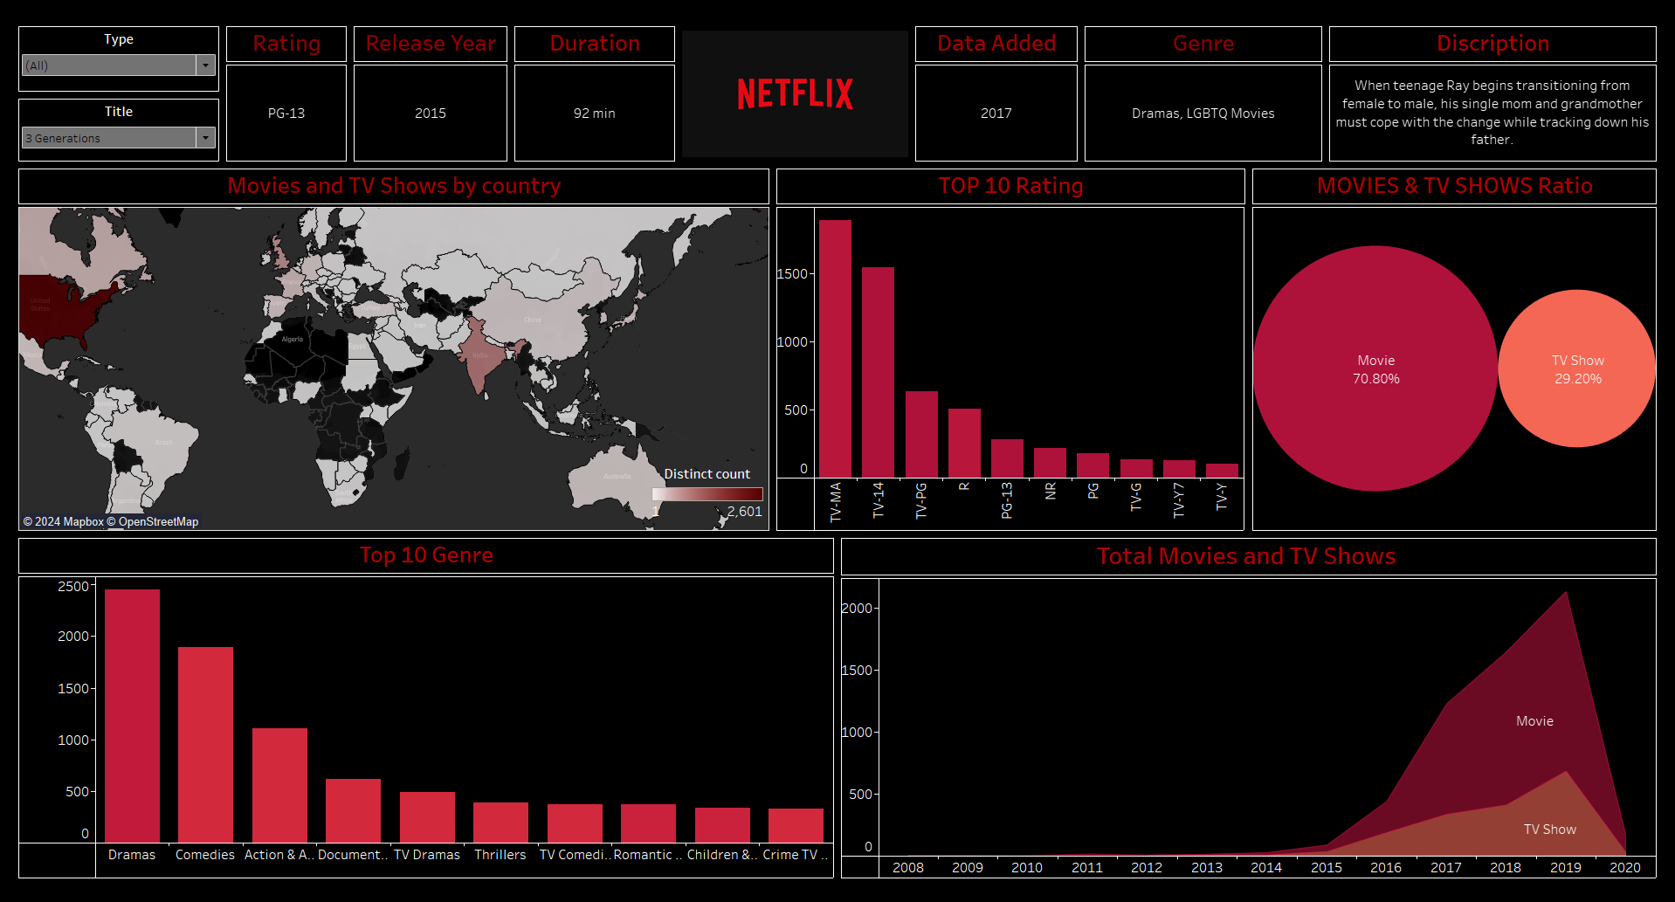
NETFLIX DASHBOARD

Slide 18
OVERALL INSIGHTS AND CONCLUSION
Content Focus: Netflix's content library is heavily focused on movies, which constitute about 70.80% of the total content, compared to 29.20% for TV shows. This suggests a strategic preference for movies over TV shows, potentially due to their broader appeal or shorter production timelines.
Genre Popularity: The most popular genre on Netflix is drama, followed by comedies and action & adventure. This indicates a strong audience preference for narrative-driven content and diverse genres that cater to various tastes.
Regional Content Distribution: The United States and India are the leading contributors to Netflix’s content library, highlighting these countries' significant role in global entertainment. Other countries like the India UK, Canada, and Japan also contribute, but there is less content from Africa and some parts of Asia, indicating potential areas for growth and expansion.
Content Trends: There was a significant increase in content additions around 2019, suggesting a period of rapid expansion for Netflix. This could be attributed to Netflix's efforts to strengthen its catalog to compete with other streaming services.
Viewer Demographics: A large portion of Netflix's content is targeted at mature audiences (TV-MA, TV-14, and R), with less content available for younger viewers. This shows a strategic focus on adult content, which aligns with the viewing habits of a significant portion of Netflix’s subscriber base.

Slide 19
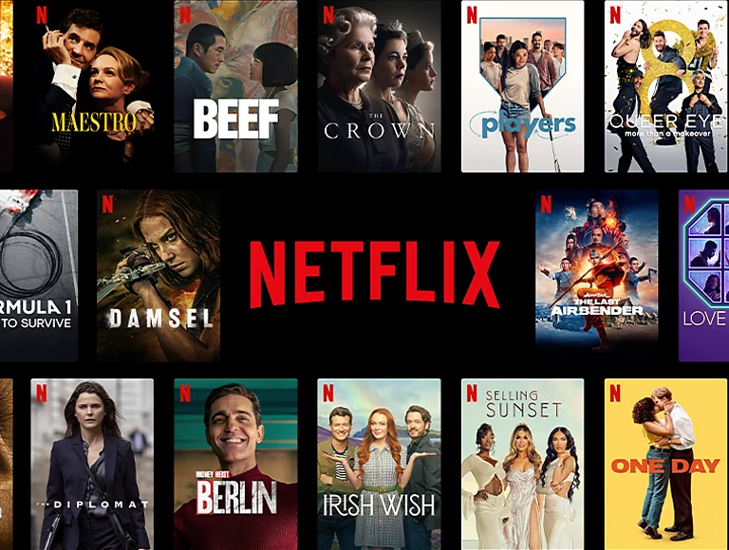
SUGGESTIONS
Expand TV Show Library: To balance the content offering and attract more subscribers who prefer episodic content, Netflix could consider expanding its TV show library.
Increase Content for Younger Audiences: With a lower percentage of content aimed at younger audiences, Netflix could develop or acquire more children’s programming to cater to families and younger viewers.
Focus on Underrepresented Regions: By investing in content from underrepresented regions, particularly Africa and parts of Asia, Netflix can diversify its content offerings and appeal to a broader global audience.

Slide 20

TOOLS USED
REFERENCES
Tableau for data visualization
SQL for data preparation and cleaning
Dataset source: Netflix Movies and TV Shows dataset on Kaggle
https://www.tableau.com/academic/students

Slide 21
PRESENTED BY APEKSHA CHIKANE , PRATIK DESHMUKH
THANK YOU !

